Slide 1

Python Conference Taiwan
2021 Post-event Report

Slide 2

“
Hi, dear sponsors, 2021 has been a turbulent and challenging year. The outbreak may have disrupted many of the original plans, but it also gave people the opportunity to jump out of their comfort zone.
This year PyCon TW has made a lot of new attempts at event design. We thank you for your trust and continued support of the event. Your participation enriched PyCon TW 2021 considerably.
Now, kindly let us lead you to retrospect what special PyCon TW has done in 2021 and how we've dedicated to expand our community.
— PyCon TW 2021
”

Slide 3
















Year in Review
About Us
Audience Numbers in our Events
Satisfaction
(Main Conference)
We have
128+
volunteers
Smoothness of paticipating conference virtually
Diversity of the program
Technical and informative knowledge acquisition
Main Confernece
560
registered participants.
Activities of conference include speaches, talks, tutorials, job fair, etc.
Young Inspires
55
peak concurrent views during the Youtube Live stream
Sprint Development
80
registered participants contribute to eight
sprint projects
We have hosted
9
Annual Conferences
4.35/5
4.37/5
We delivered (Main Conference + Young Inspires Forum)
Sponsorship
The speeches and professional courses lasted a total of
30.75 hours
20+
sponsors
3
Keynotes
40
Talks
3
Tutorials
4.58/5
1
1
7
3
10

Slide 4

TABLE OF CONTENTS
Each underlined character is a hyperlink
PyCon TW 2021 Online Platform Usage Performance
#YoutubeLive #GatherTown
04
01
Retrospection:
PyCon TW 2021 Hilights
#PyCast #YoungInspires #Sprints
05
Feedbacks from Attendees
for PyCon TW 2021
PyCon TW
Social Networking
Performance Overview
02
06
Misc
03
PyCon TW 2021
Main Conference Profile
You could click the icon in the bottom right corner,
to return to the contents page
Notes:
銅級贊助商、PSF、Gather Town「沒有」第六章

Slide 5
TABLE OF CONTENTS
Each underlined character is a hyperlink
PyCon TW 2021 Online Platform Usage Performance
#YoutubeLive #GatherTown
04
01
Retrospection:
PyCon TW 2021 Hilights
#PyCast #YoungInspires #Sprints
05
Feedbacks from Attendees
for PyCon TW 2021
PyCon TW
Social Networking
Performance Overview
02
03
PyCon TW 2021
Main Conference Profile
You could click the icon in the bottom right corner,
to return to the contents page
Notes:
銅級贊助商、PSF、Gather Town「沒有」第六章

Slide 6
Chapter 01
Retrospection:
PyCon TW 2021 Hilights
#PyCast #YoungInspires #Sprints

Slide 7


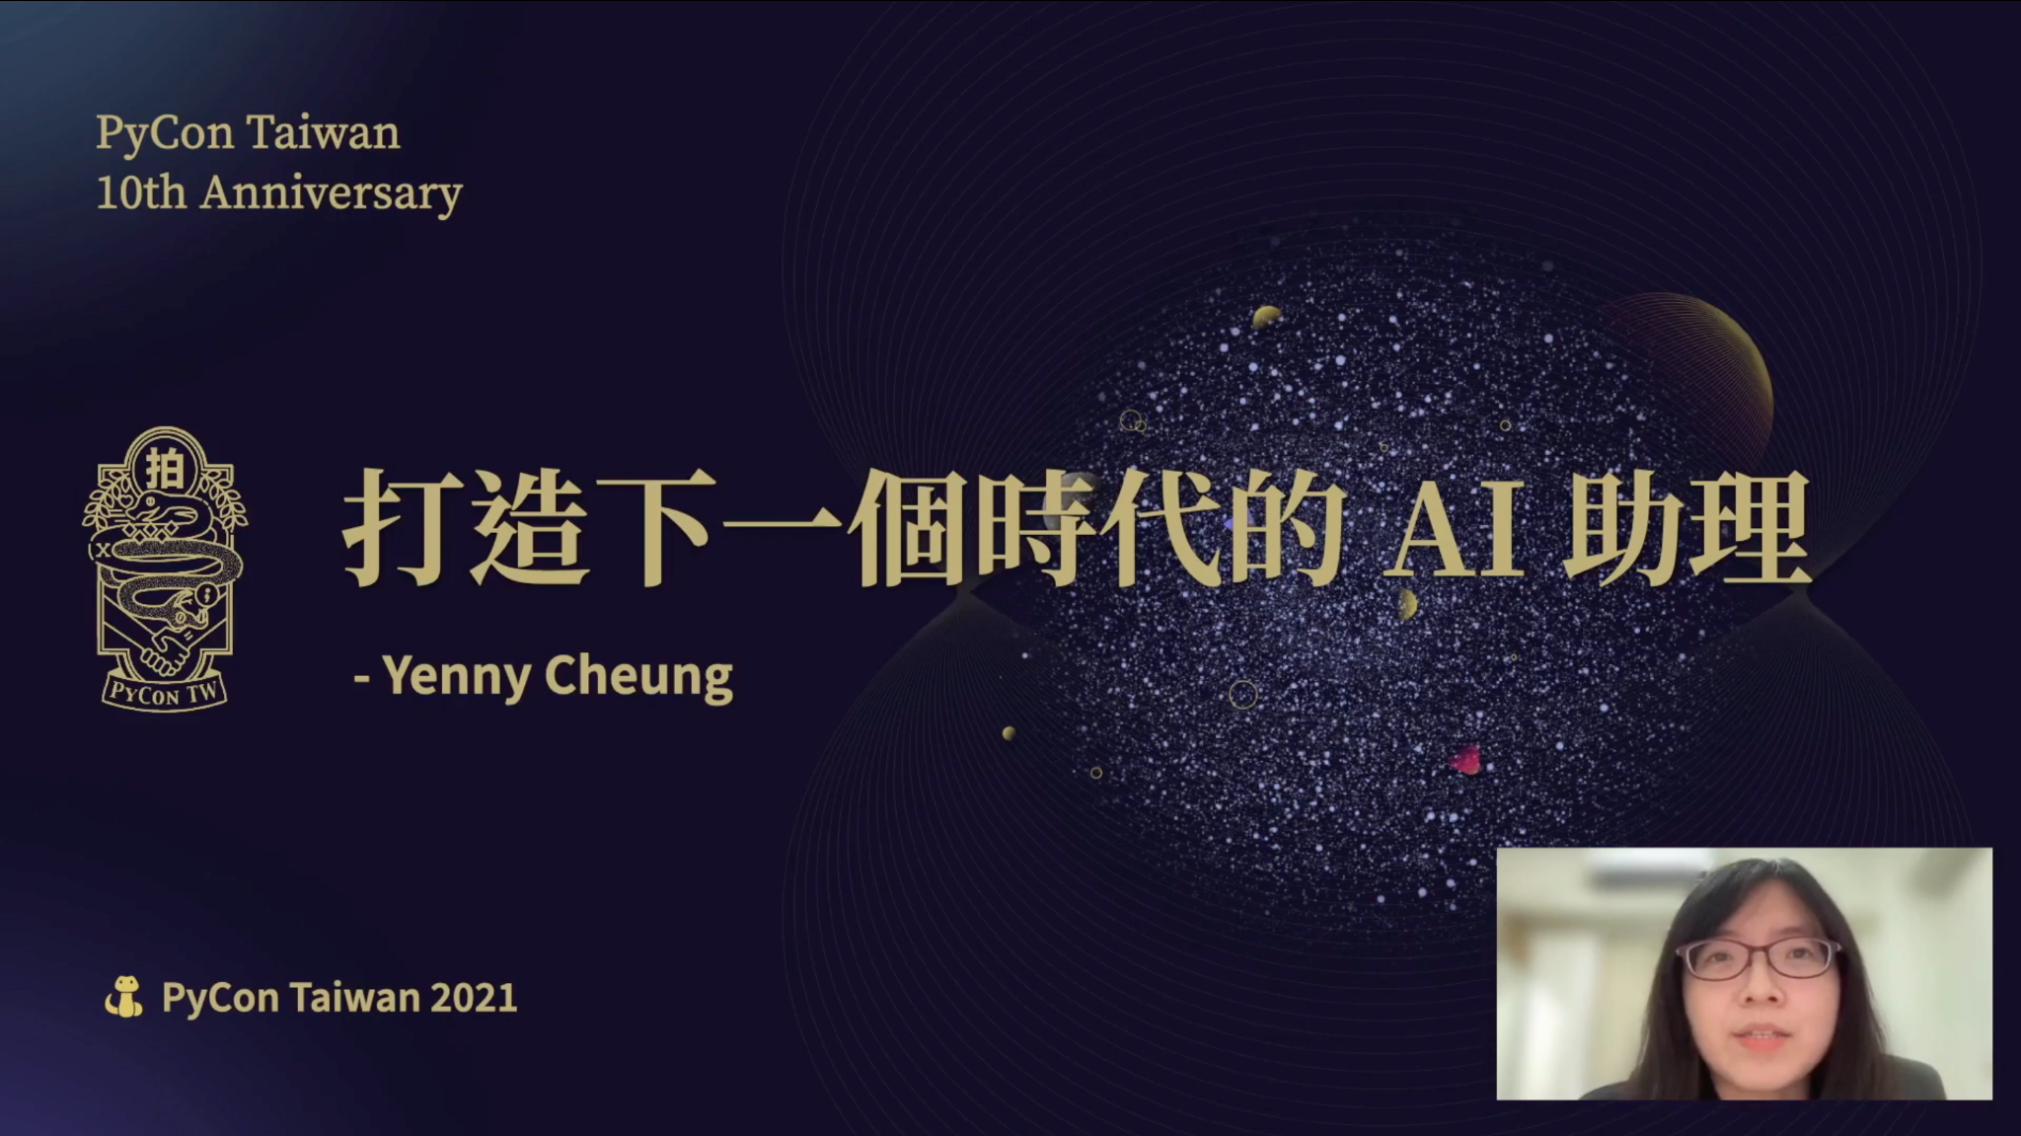
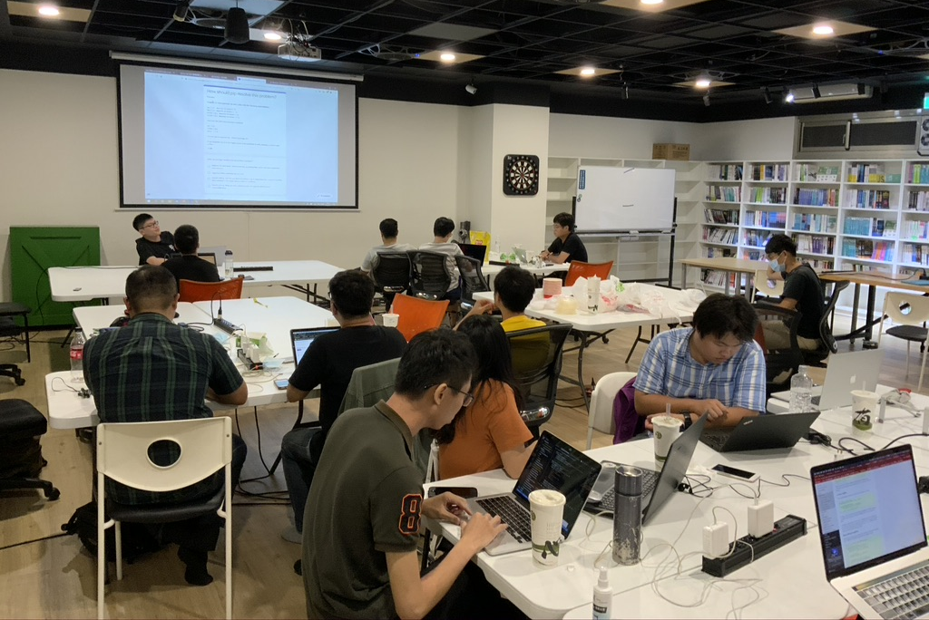
Milestones of PyCon TW 2021
“PyCast” Released
2021
Apr. 12
(Official Podcast)
“Young Inspire” Forum
Debut
2021
Aug. 14
2021
Sep. 26
Sprints
Main Conference
2021
Oct. 2, 3

Slide 8
PyCon TW 2021 Highlight - PyCast
7
19
Published Episodes
Country / Region
3300+
7 th
Total downloads
Peak Position
(in August)

Slide 9

PyCon TW 2021 Highlight - PyCast
The Highest Audience Rate
Trailer
Episode 4
一 Py 即合～ PyConTW 開節目囉！
Quark Engine(上) - 資安
工程師都在做什麼？
ft. Kunyu, Junwei
Episode 1
Episode 5
一起來聽 PyConTW 創始元老 YYC 說說那些年的起源故事
Quark Engine(下)，Android惡意程式的百科
全書！ft. Kunyu,Junwei
Episode 2
Episode 6
職場邊緣人教你如何讓 WFH 變得更有趣
在科技新創實習的高中生 ft. 蔡佳恩Jacklyn
Episode 3
Episode 7
下班已經很累了，
為什麼還要當志工？
【特輯】連主持人都不知道有隱藏活動之 PyNight 精華

Slide 10
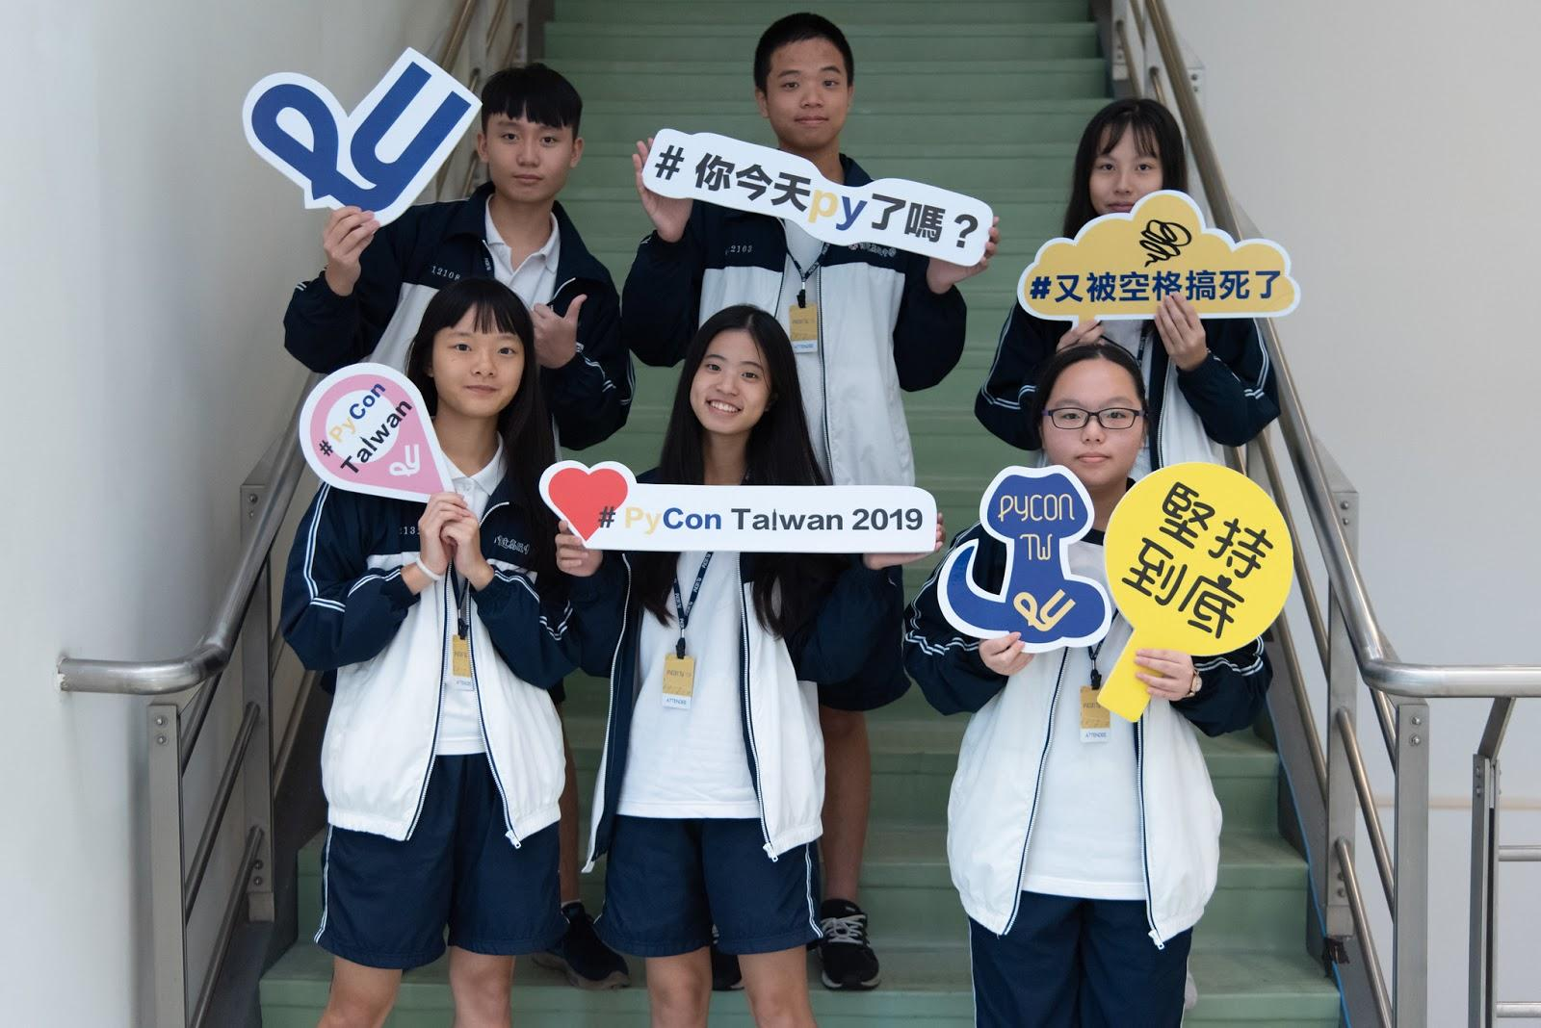
PyCon TW 2021 Hightlights -
“Young Inspires” Forum
55
6.5K+
550
Live Viewers
(Concurrent)
Impressions
Views
Young Inspires is the first online conference for student speakers to share their learning experiences in science and technology fields. With this event, we hope to promote the communication between talent Young Inspirers and Python community.

Slide 11


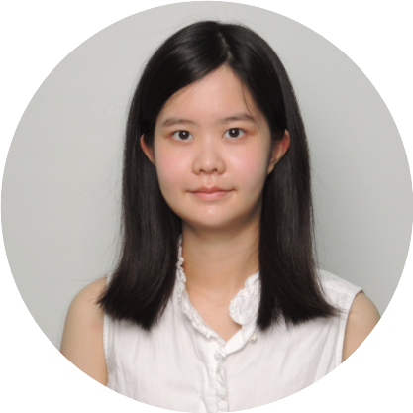
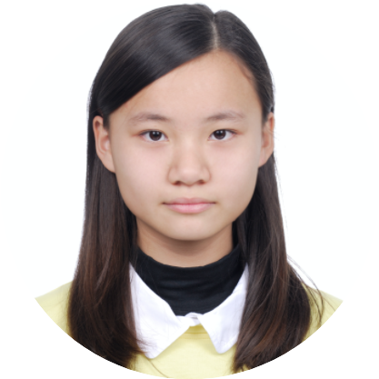
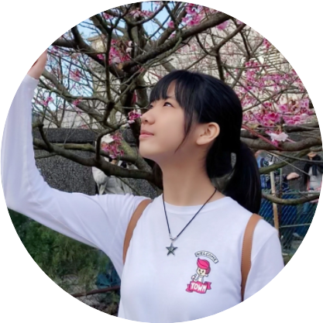
PyCon TW 2021 Hightlights -
“Young Inspires” Speakers
Wey-Han Liaw
Software Engineer at Intentionet, Inc., U.S.A
Speech Topic：For Those Days of Self-studying at Home
Chia-En Tsai
Freshman of Columbia University
First high-schooler intern at CyCraft Technology CO., LTD.
Speech Topic：HighSchooler in Technological Startup
李米蕙 / 蔡仲淇
Won the first place in 2021 GiCS (Girls in CyberSecurity) contest
Speech Topic：Get Up Close and Personal with Technology through AI Clubs
Notes:
附上官網補充資料 https://tw.pycon.org/2021/zh-hant/conference/young-inspirers

Slide 12
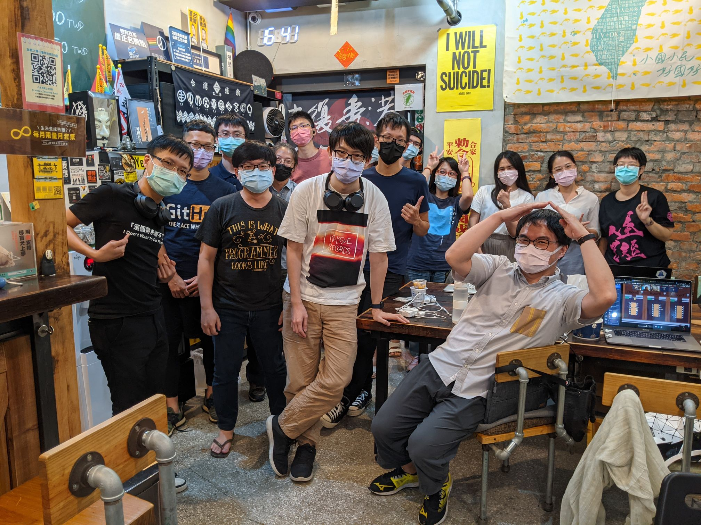
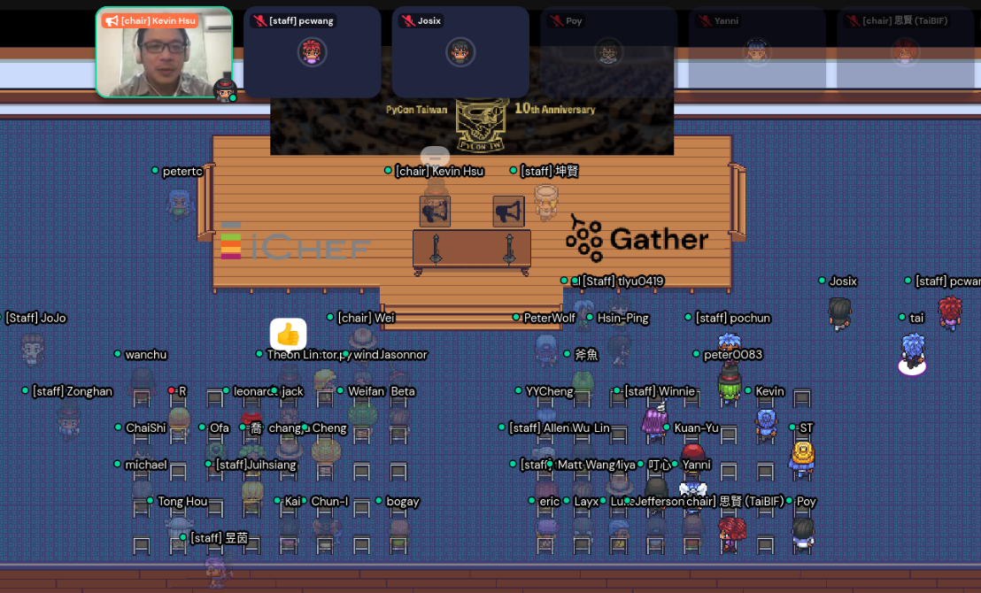
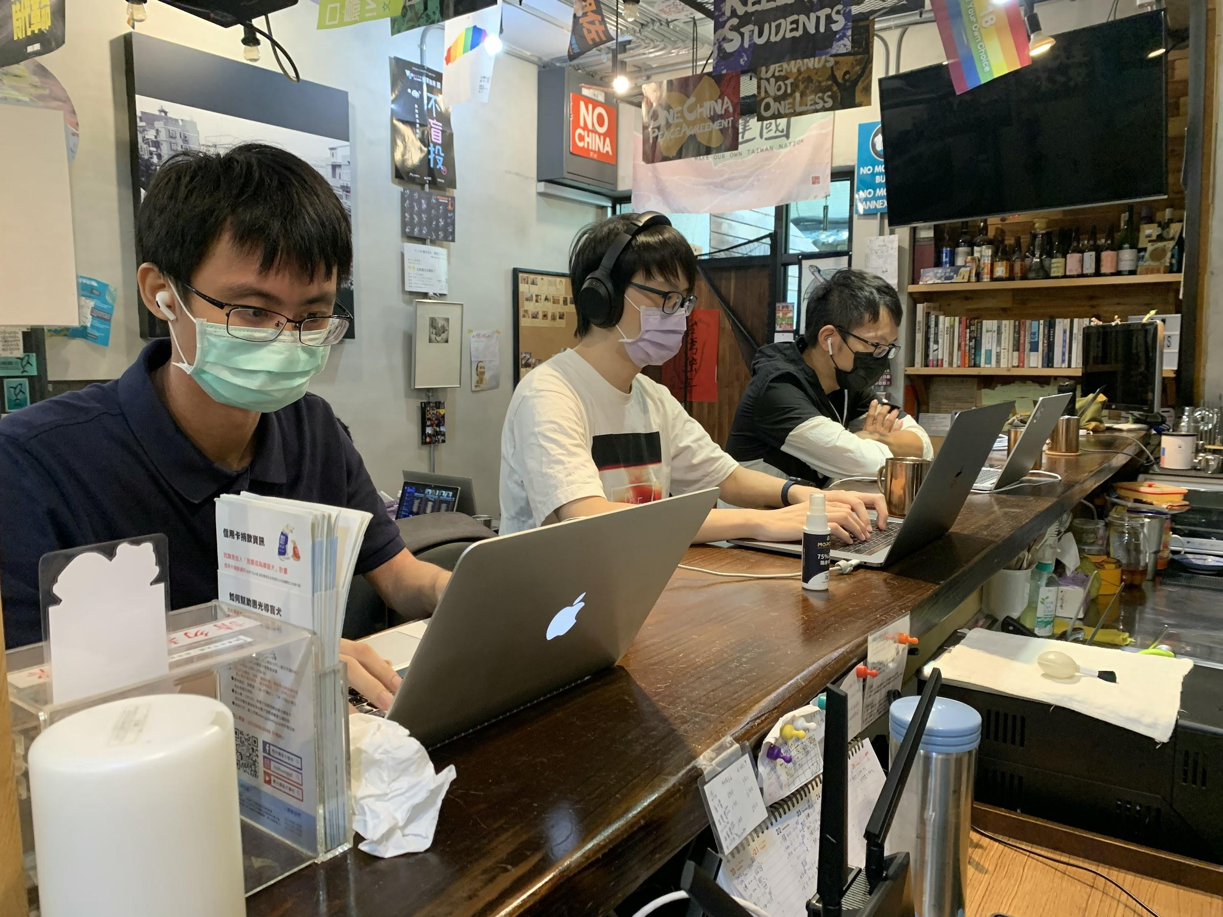
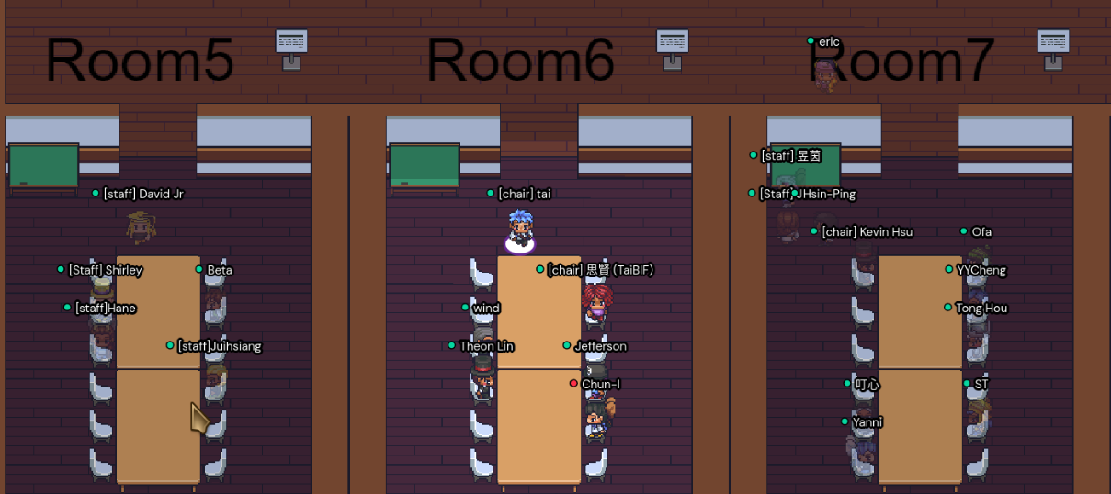
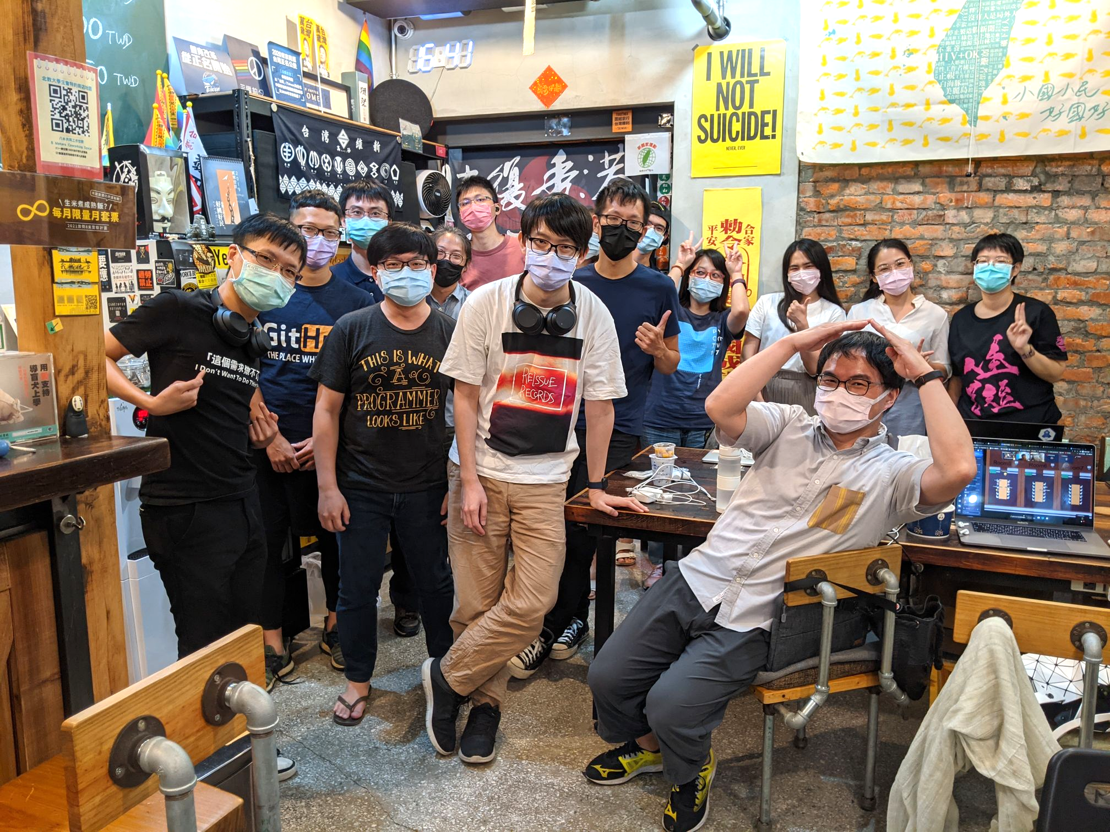
PyCon TW 2021 Hightlights - Sprint
80
Hybrid Sprint
Virtually in Gather Town
Projects Around the World
Tickets Sold
(sellout)
8
Sprint
Projects
Sprint is an event that gathers people who want to contribute to open source projects but don't know how to start. There will be project leaders who will explain the features of their projects to be developed on the spot. Participants can choose to join their favorite projects or bring their own projects to share with others!

Slide 13
Chapter 02
PyCon TW
Social Networking Performance Overview

Slide 14
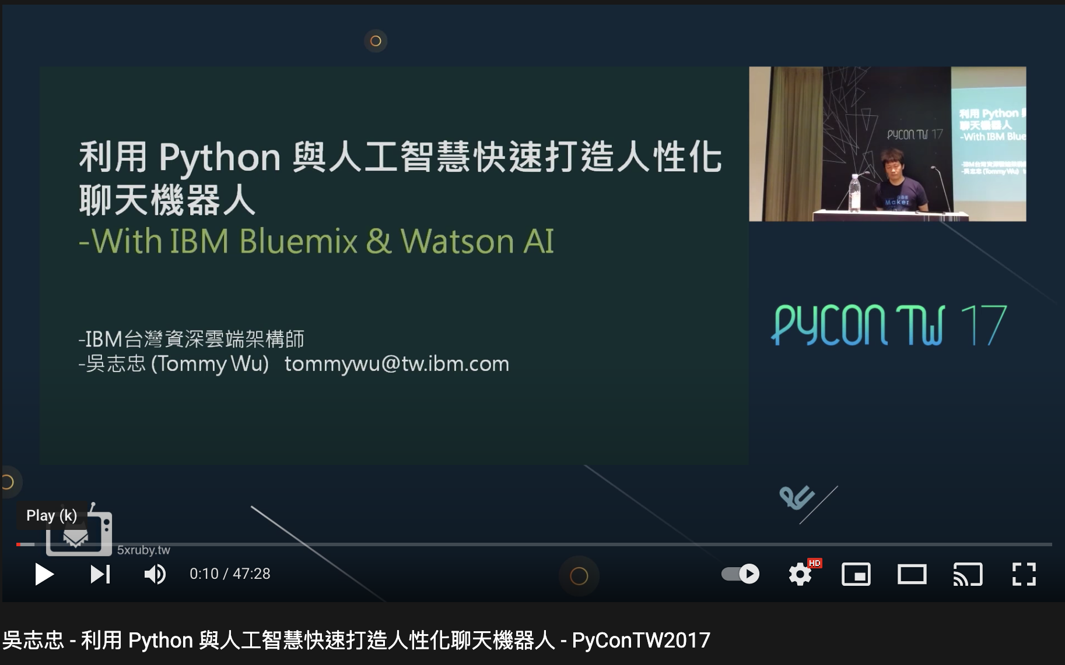
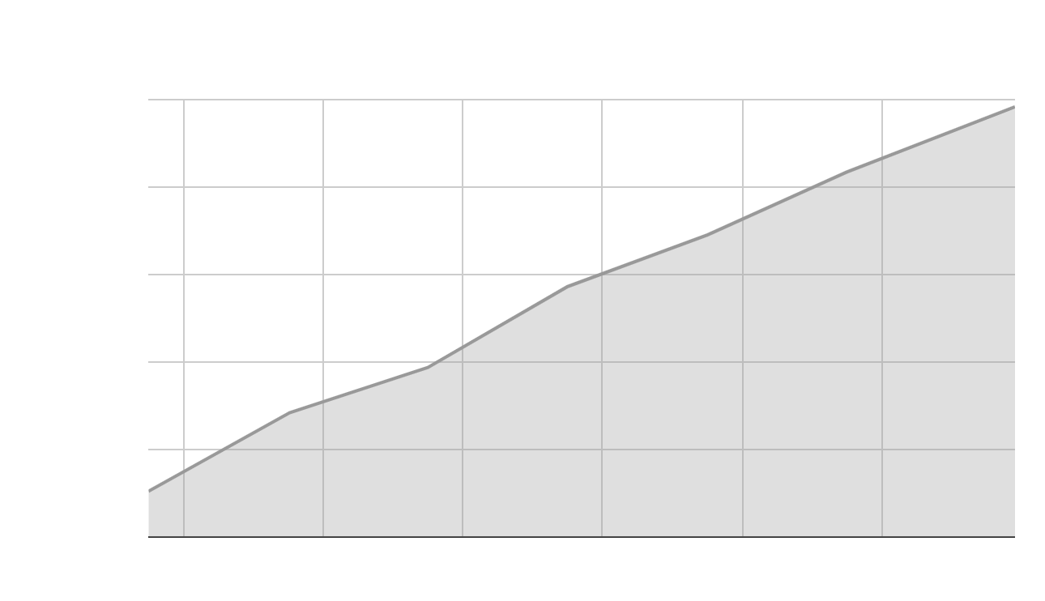

Youtube Channel Status
22K+ views
10K+ views
PyCon TW channel got 41.4K views in 2021. As the number of subscribers increase year by year, we expect our video impressions will continue to rise steadily.
4900+
Subscribers
in December, 2021

Slide 15
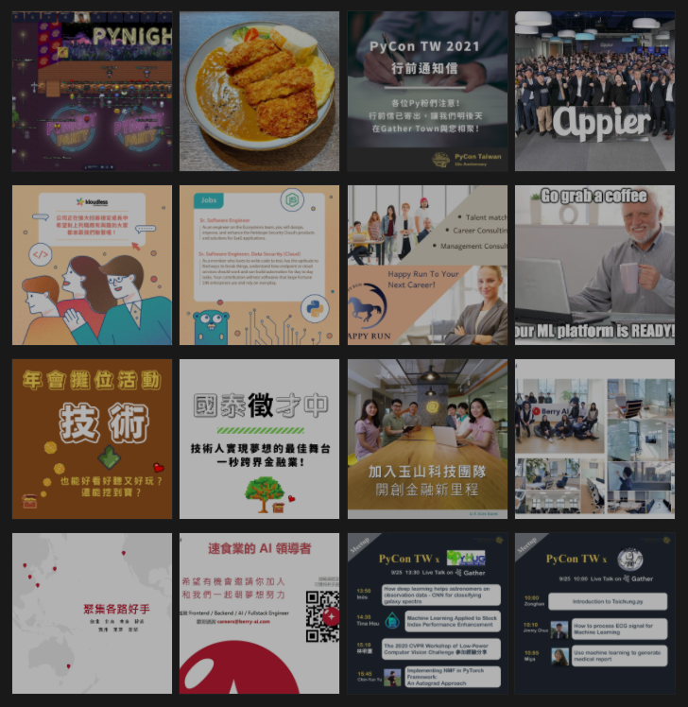
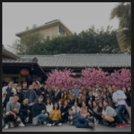
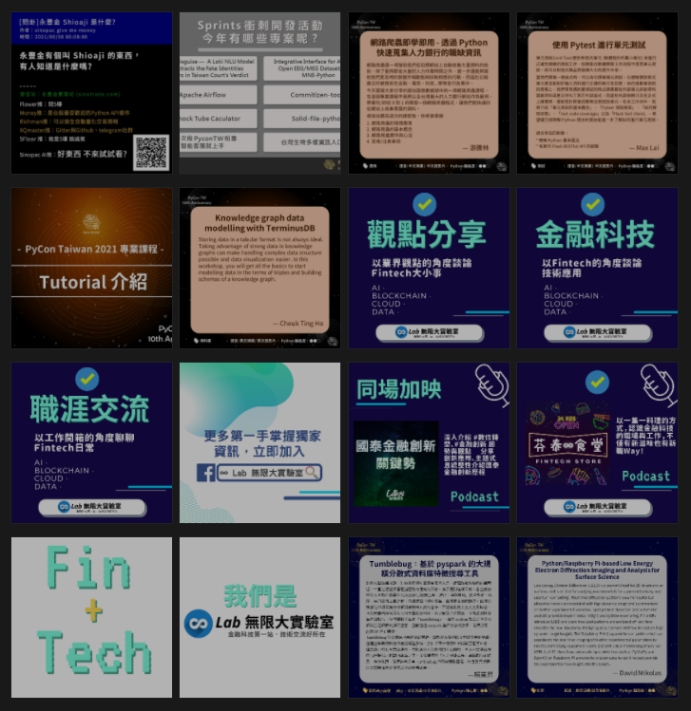
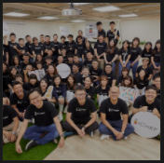


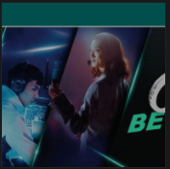
Facebook Fan Page
10011
71000+
Followers
Post Reach/day
(maximum in Sep., 2021)
Notes:
Post reach daily AVG: 12254

Slide 16
Chapter 03
PyCon TW 2021
Main Conference Profile
#RegisteredParticipants #Speeches

Slide 17

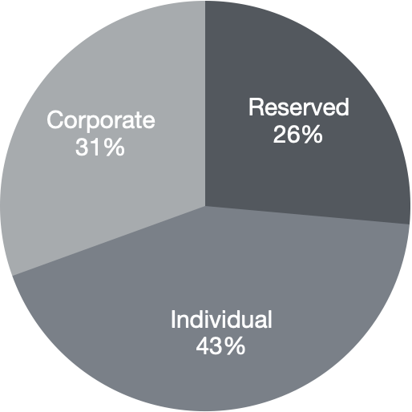
Sales Status of each Ticket Types
A vibrant community with even sectors !
 | Sales
Reserved | 148
Individual | 241
Corporate | 171
Note: Reserved tickets are for speakers and contributors. Individual tickets are sold to natural persons. Corporate tickets include complimentary tickets for sponsors and group buying from enterprises.

Slide 18
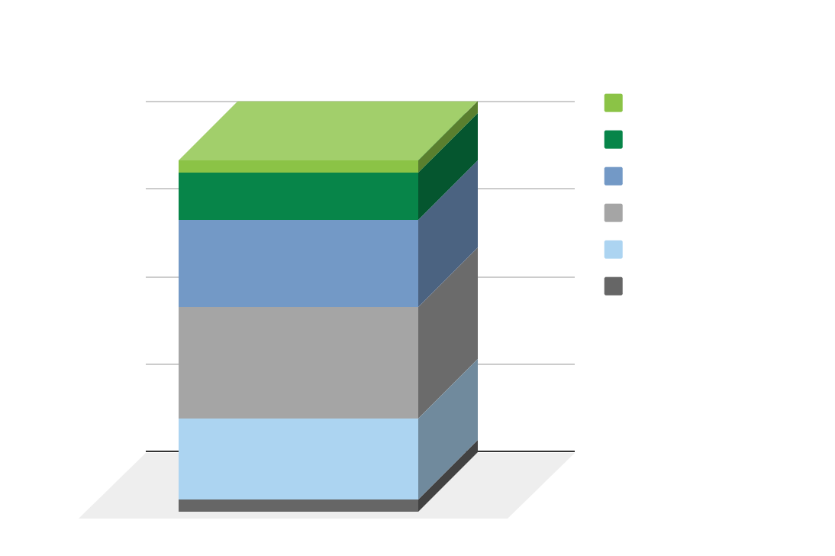
Registered Participants Profile
(individual tickets buyers)
3%
The mode of seniority level of using python among registered paticipants is
1-3 years
14%
26%
33%
24%

Slide 19

Registered Participants Profile
(individual tickets buyers)
Occupational Fields Top 3
01
02
03
Web Service
Medical
&
Health Care
Artificial Intelligence

Slide 20


Registered Participants Profile
(individual tickets buyers)
Medical & Health Care
Manufacturing
Semiconductor Manufacturing
Education
The right list shows trends in the occupational fields of participants compared to 2020
Web Service
Artificial Intelligence
IC Design
Financial

Slide 21
Registered Participants Profile
(individual tickets buyers)
Fields of Interest Top 5
Engineering &
Mathematics
Data Analytics
Web Development
01
02
03
04
05
Artificial Intelligence
Machine Learning
Deep Learning
DevOps

Slide 22



More Information
Trends in the Fields of Interest of Participants
FinTech
Engineering
Business
Science
Technology
Web Technology
AI / ML / DL
DevOps
Security

Slide 23
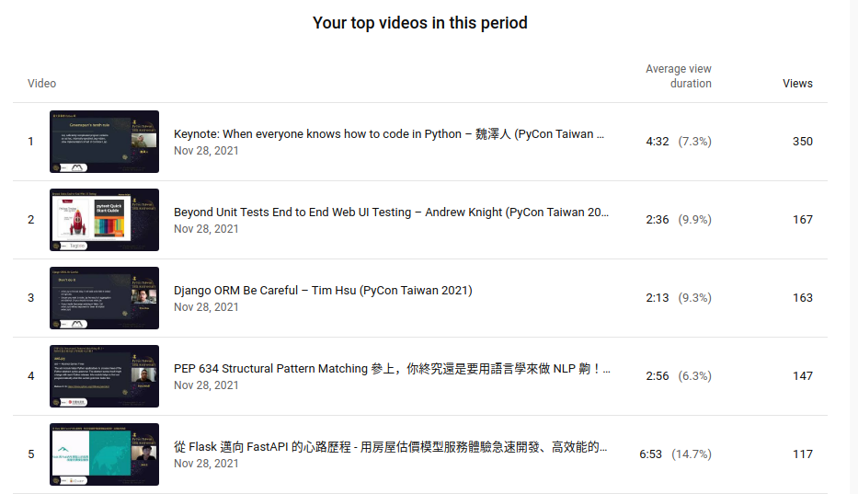
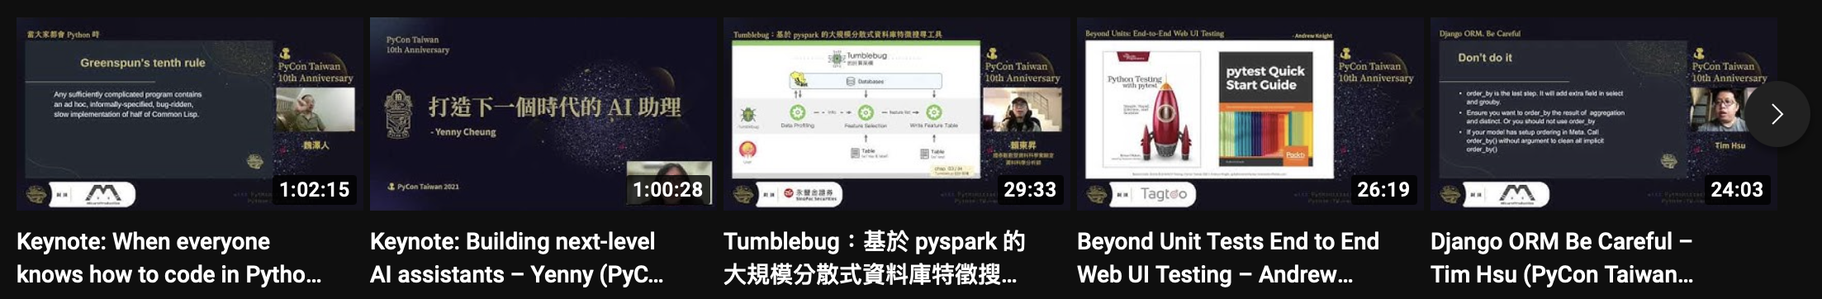
– High Diversity –
19 Categories (Proposal)
15 Categories (Accepted)
Core Activities - Talks & Tutorials
– High Quality –
Accepted Rate: 42.5%

Slide 24
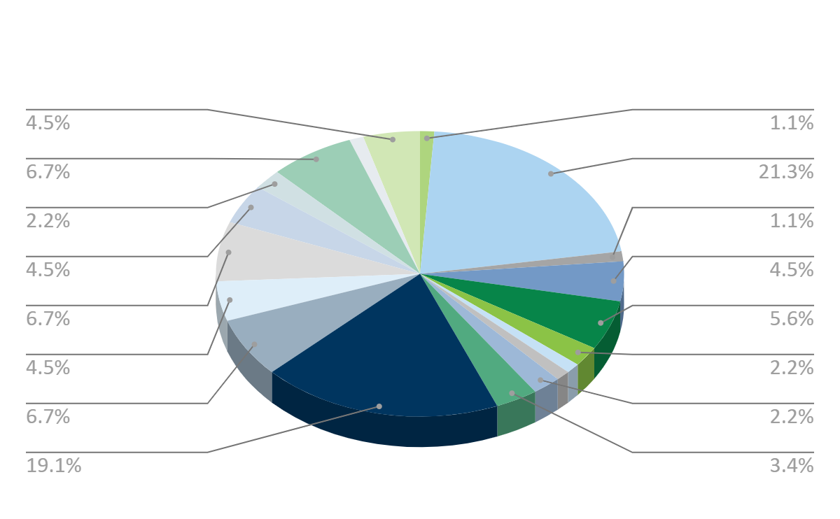
Core Activities - Talks & Tutorials
The number of contributions
Talk
Duration | Counts
30min | 61
45min | 14
15min | 8
Tutorial
Duration | Counts
1.5hr | 4
We received 87 proposals which cover 19 categories!

Slide 25
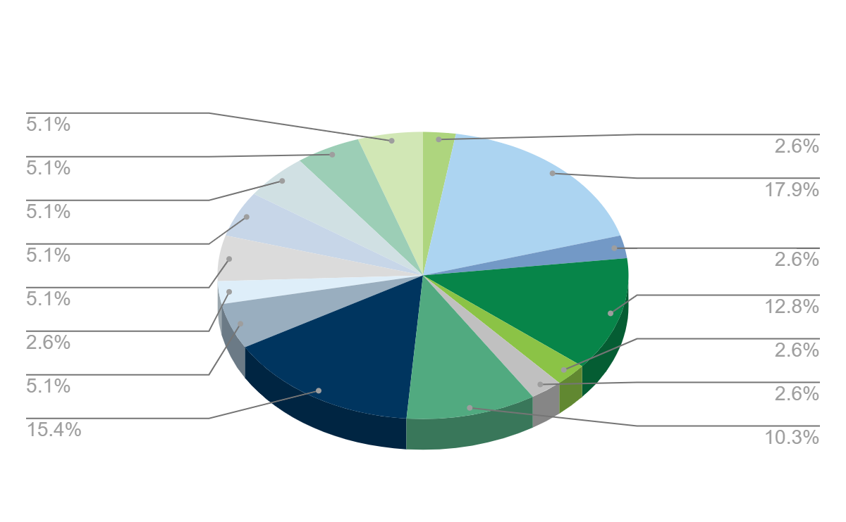
Core Activities - Talks & Tutorials
Numbers of Accepted Proposals
Talk
Duration | Counts
30min | 24
45min | 10
15min | 3
Tutorial
Duration | Counts
1.5hr | 3
To enrich the conference, we maintain as diverse a theme as possible.
37 talks and 3 tutorials are selected. They cover 15 categories!

Slide 26
Chapter 04
PyCon TW 2021
Online Platform Usage Performance
#YoutubeLive #GatherTown

Slide 27
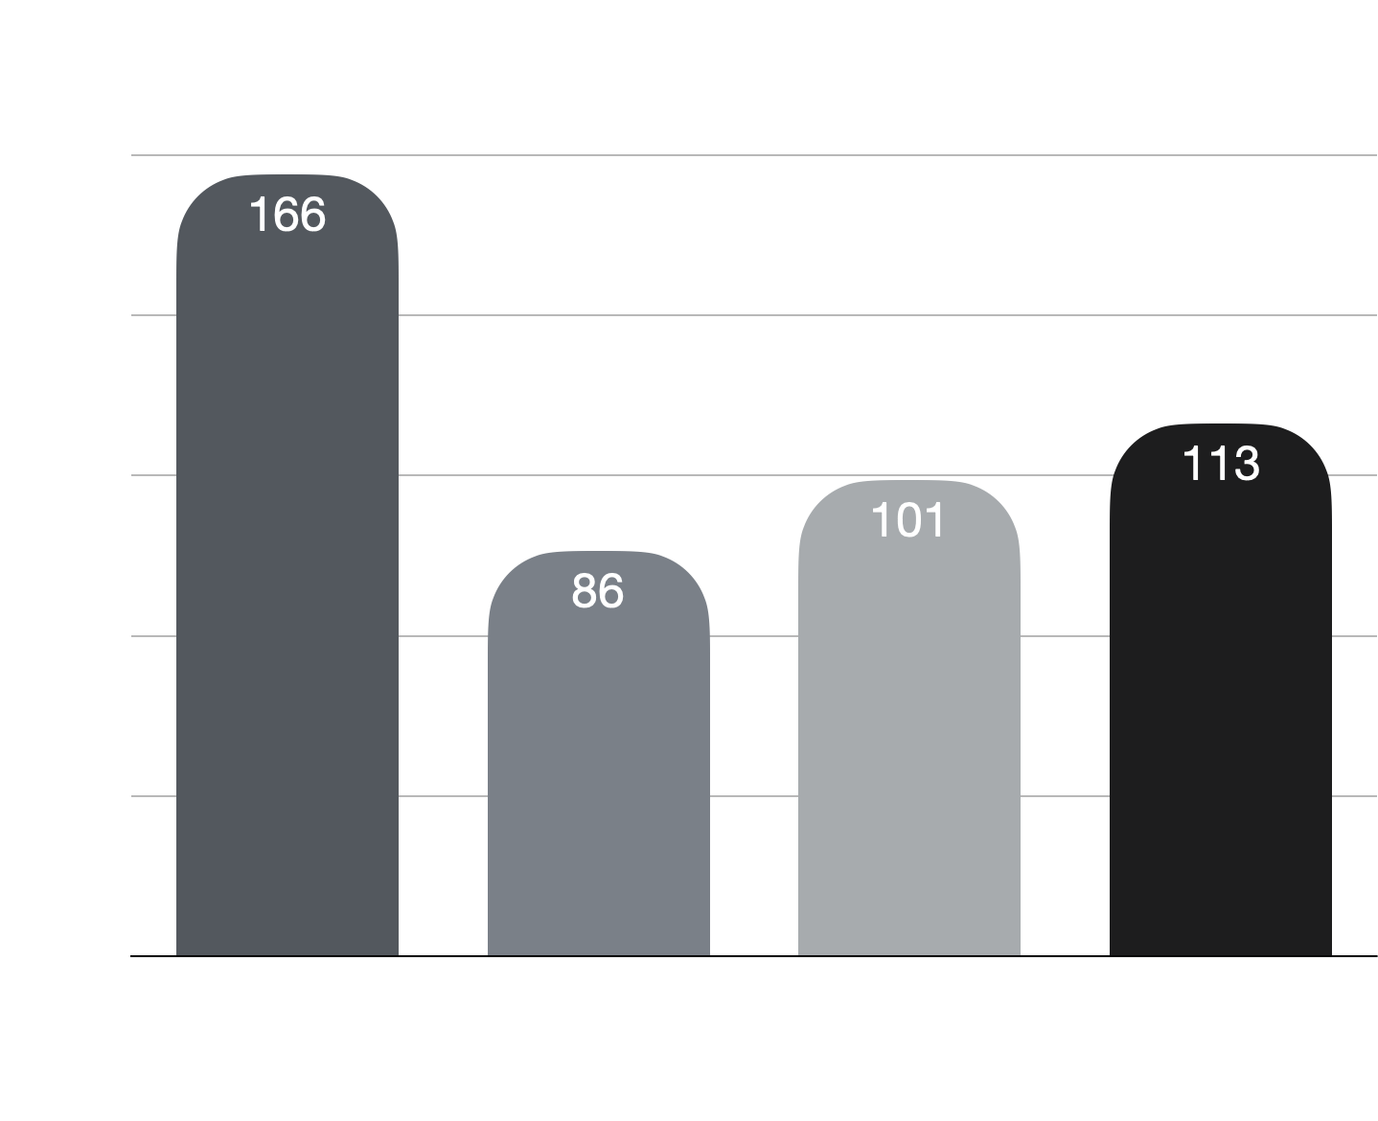
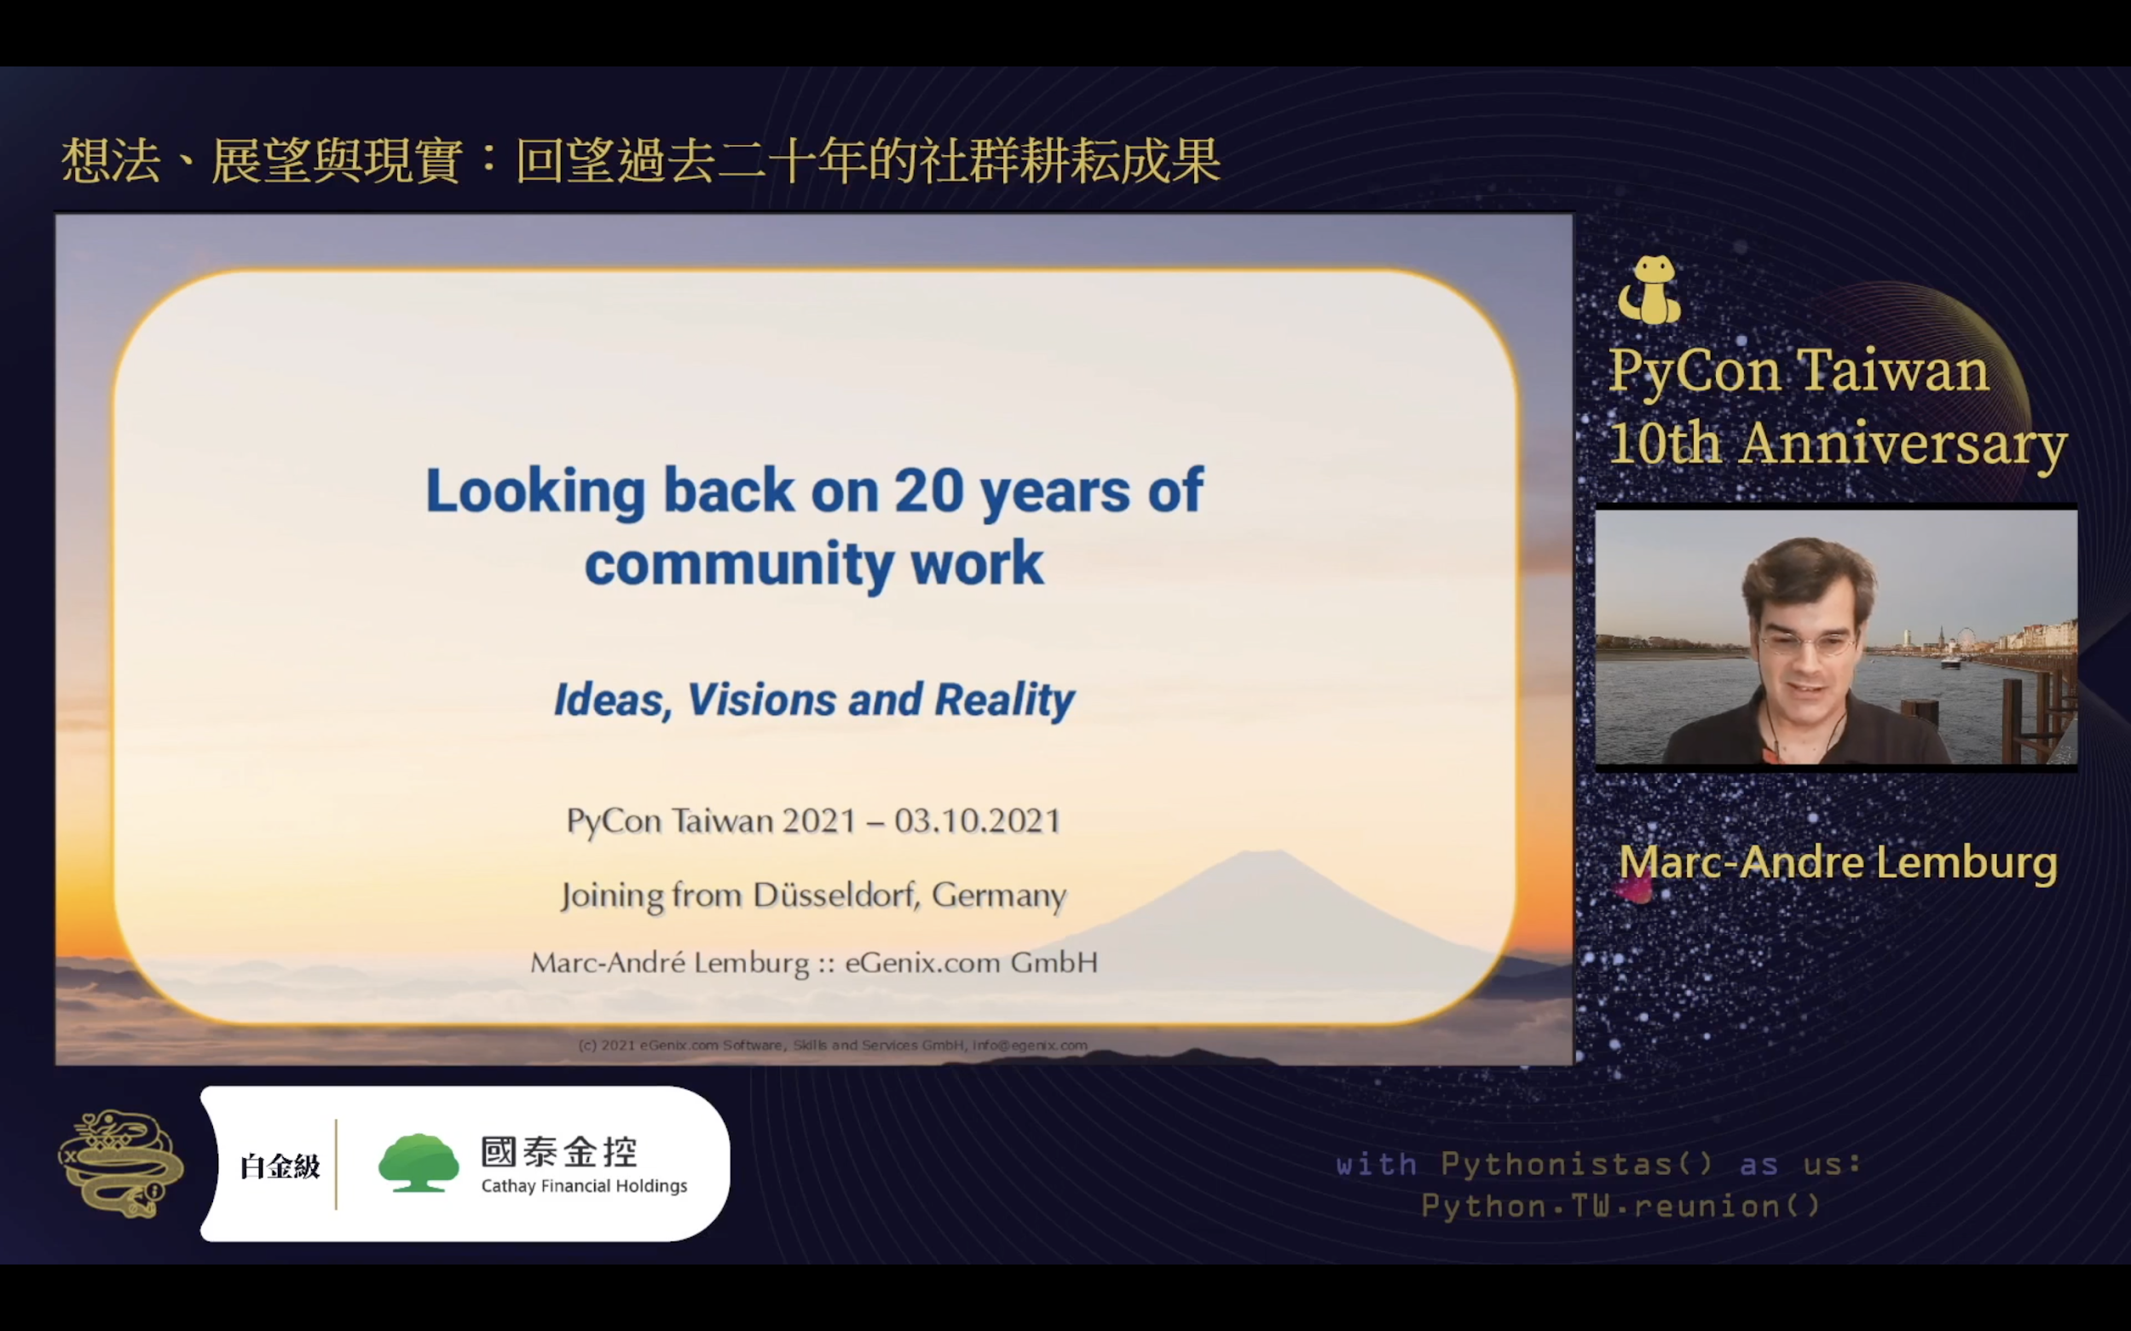
Online Platform - Youtube Live
The Concurrent Viewers of
Live Streaming Reaches
466

Slide 28
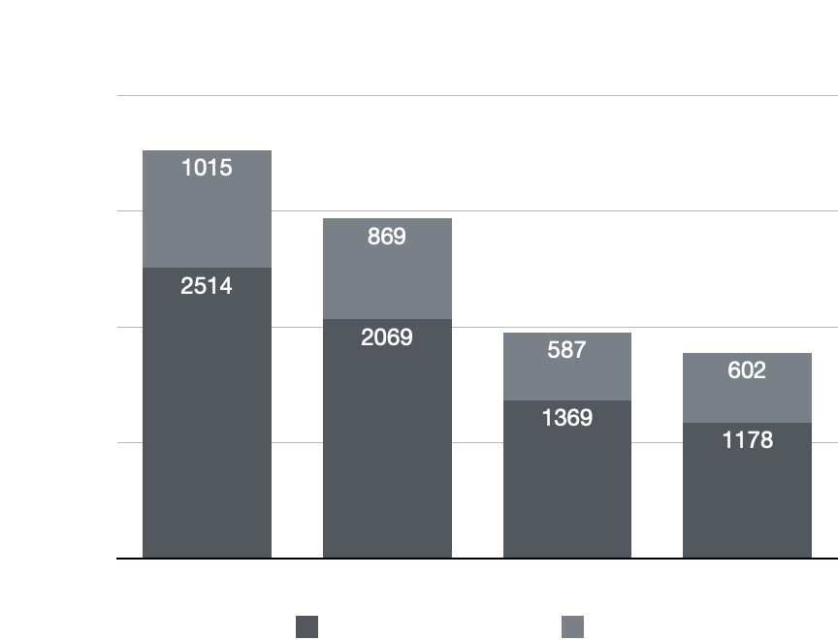
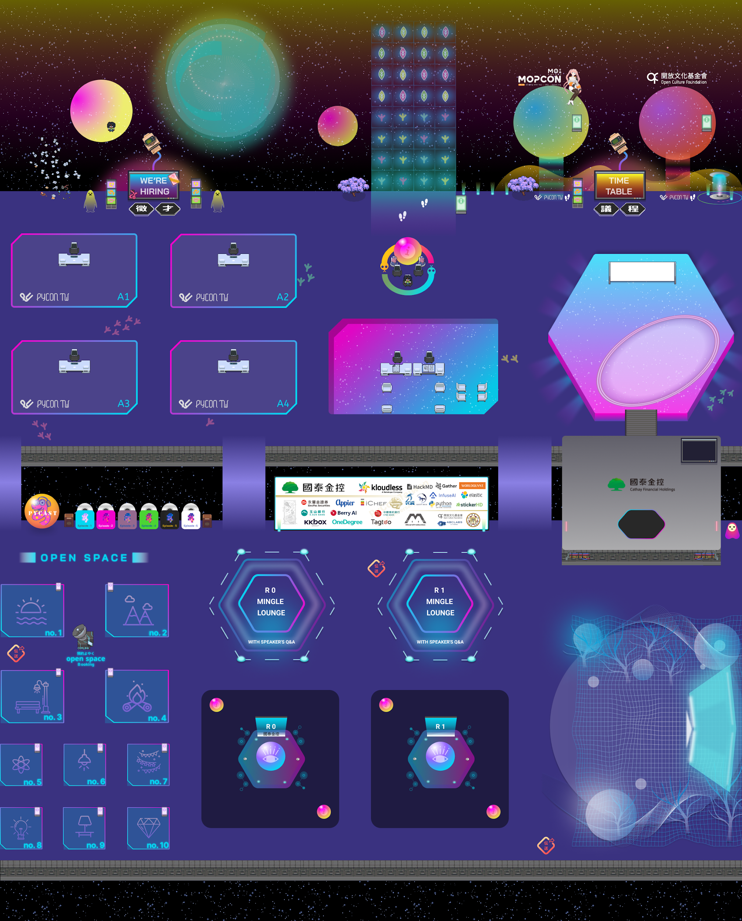
Online Platform - Gather Town
1.1
2.1
1.2
2.2
Maximum number of Concurrent Users
Space 1 : 170
Space 2 : 125-130

Slide 29
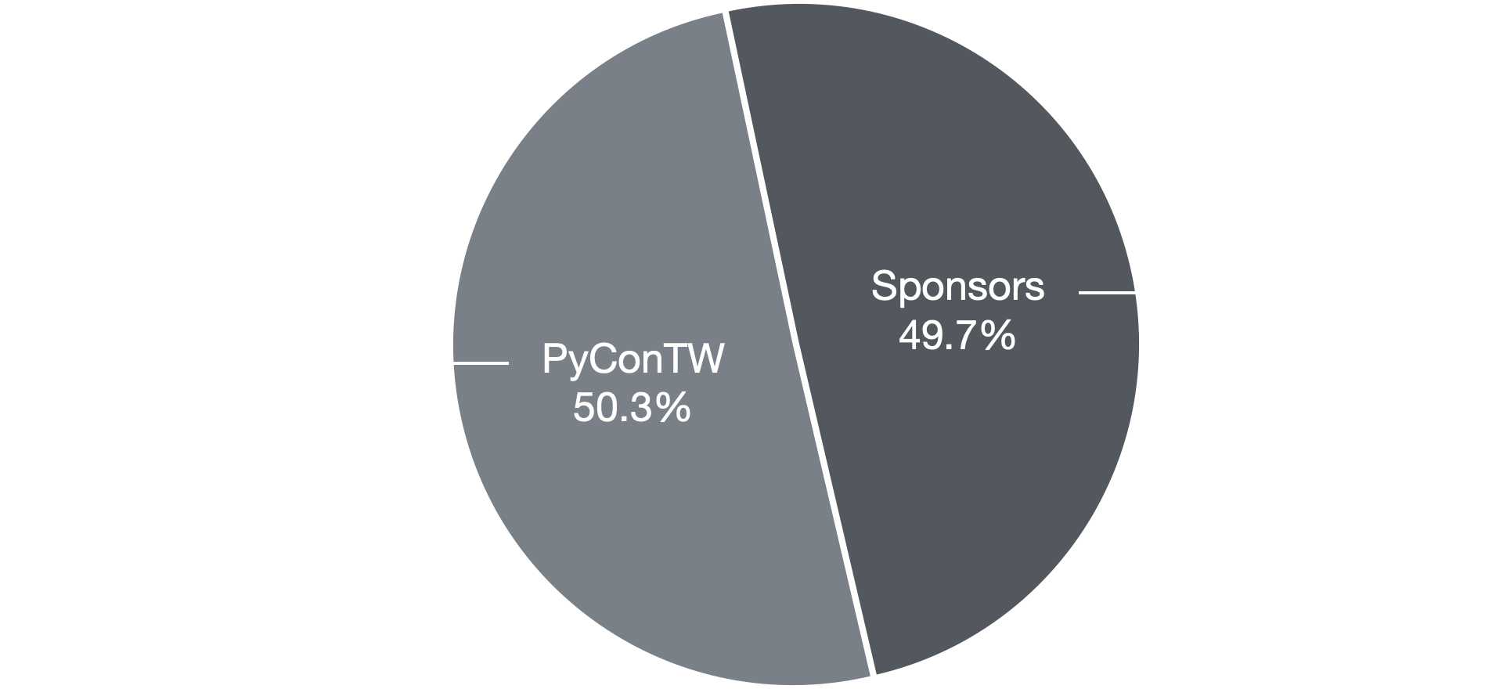
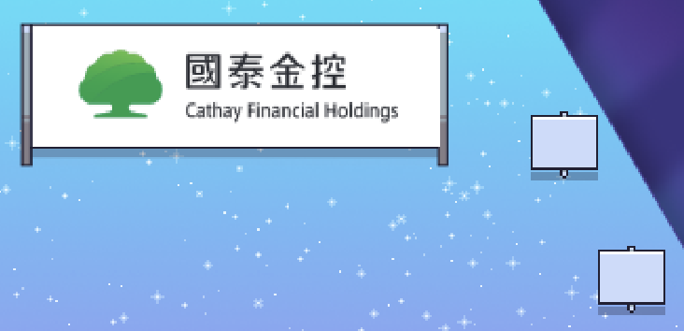
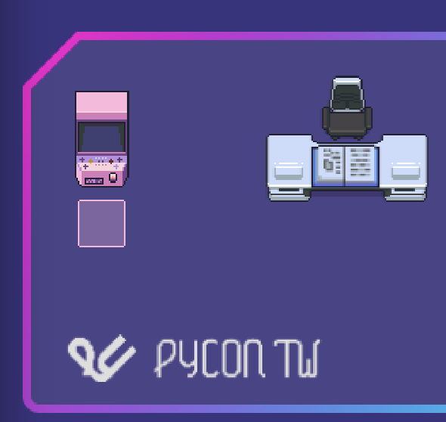

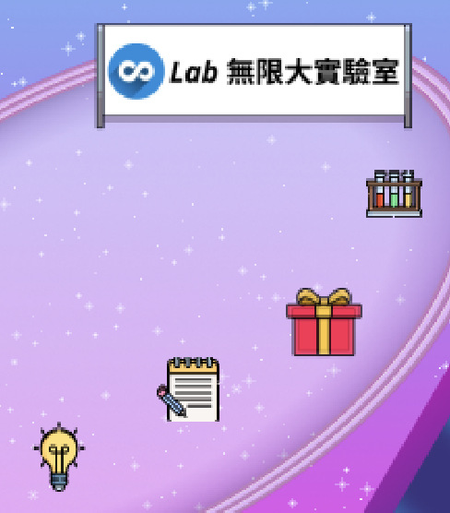
Online Platform - Gather Town
49.7% of the overall clicks are collected from sponsor booths in two spaces

Slide 30
Online Platform - Gather Town
EVENT | Activities within Gather town Venue | Attendees | Dates | Frequency
PyCon TW 2021 | Attendees’ main communication, Q&A, and topic sharing. | 560 | 10/2~10/3 | 1
Sprint | co-working on coding projects. | 80 | 9/26 | 1
After Party (PyNight) | The attendees’ party on the first day of PyCon TW 2021. There were raffle games, music performance, and short speeches. | 50~112 | 10/2, 18:45~21:00 | 1
Regular Members Meeting | bi-weekly meetup for task assignment & website development | 14 | Every other week since May, 2021. | 9
MeetUp | Speakers shared talks with our Python Communities. | 35~50 | 9/25 | 2
Unboxing Day | Various cyber communities are invited to peak at our main venue of PyCon TW 2021 in advance. | 24 | 9/18 | 1
Demo Day | Our sponsors are guided through the main venue of PyCon TW 2021 in advance to be familier with Gather Town. | 20 | 9/3,9/4 | 2

Slide 31
Chapter 05
Feedbacks from Attendees
for PyCon TW 2021

Slide 32
Activity Satisfaction
Smoothness of Participating Conference Virtually
Technical and Informative Knowledge Acquisition
Diversity of the Program
4.35/5
4.37/5
4.58/5
The participants gave PyCon TW 2021 a rating of 4.4 points out of 5 on average for each metrics!

Slide 33
Other Feedbacks
Fields of Attendees Mainly Attend or Would Like to Recommend
01
02
03
Application
Testing
Data Analysis

Slide 34
Other Feedbacks
Activities that Made Special Impression
01
02
03
Lightning Talks
Tutorial
Open Space
Notes:
取前三

Slide 35






Words from Participants
在這場研討會中，除了聽到專業知識以外，也看到了很多領域內的先進投注了大量的熱情使用python去實現想做的事情，鼓舞了我。能有這次的機會參加，覺得十分幸運，收穫良多，特別是在正在學習的測試過程方面，不管是使用的小技巧、注意事項以及大方向觀念，都變得更有脈絡了。謝謝不吝分享的講者呈現的專業知識，大會舉辦協力人員的協助以及其他參與者提出的問題，都讓這個研討會及內容十分豐富、極具魅力。
Thank you for bringing us such a great event in this hard time.
▪️覺得線上的方式很方便，聽到與原先預期不符的演講可以馬上切到其他議程，同時有兩場想聽的演講也能先聽一場，後續再回另一場重播
▪️覺得這次年會線上運作的方式很棒，用gather town也很讓人有實際參與的感覺
每年最期待的知識饗宴 謝謝你們的努力
學了很多，線上對不方便去台北的人方便許多，有多認識了些關於 python 的社群
Good event as always
我愛 PyConTW!
Notes:
加上gather town avartar

Slide 36




Words from Participants
今年滿棒的～會場佈置很好、大家相處也很愉快，氣氛很不錯😊
今年第一次參加，學到很多東西，覺得兩天的活動一下就過去了，很好玩！
這個Gather.town會場的規模和豐富(花俏)程度遠超過我的想像，對於可以參加到這麼高知識含量、眾大大雲集與兼具趣味性的線上活動，這兩天真的覺得超開心，超棒的！謝謝你們！
我很喜歡會場很多開放空間和Lounge區塊的設計，雖然我寫Python是新手，但在會場亂逛聽到很多大大們的討論和各種議題的分享(或閒聊)真的是很有趣，也得到一些啟發；上周的Sprint也很好玩，很希望未來有多一點機會可以參加類似sprint或是worshop性質的活動，和大家多討論交流~
辛苦各位工作人員，在疫情嚴峻的情況之下，讓我有這盛會可以參與，也打破交通場域限制，非常感謝
希望明年 PyCon APAC 由台湾承办哦！

Slide 37
Chapter 06
Misc

Slide 38
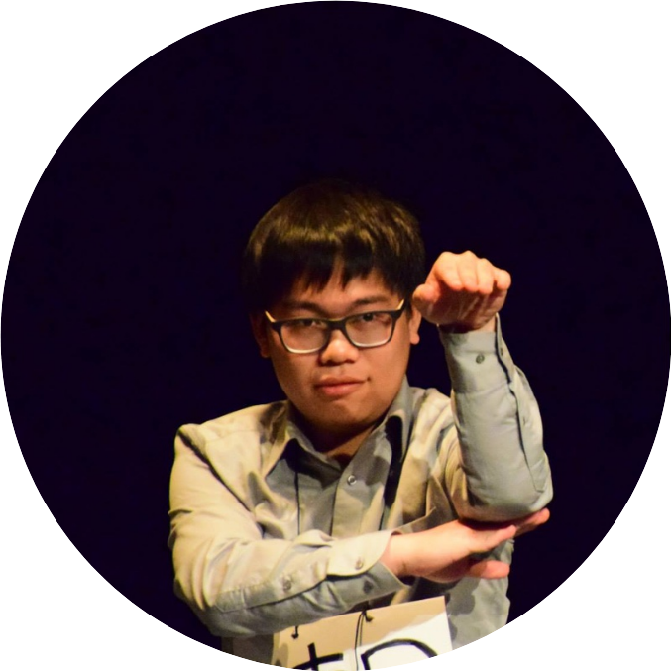

Talks Live Stream’s Metrics
Category：Natural Language Processing
Live Channel：Day2 R0
131
Total Views
(Dec. to Dec.)
54
95+
54 + 77
Views Counted
(Dec. to Dec.)
Live Viewers
(Concurrent)
賴東昇 Eric
Live Viewers
(Concurrent)
Views Counted
(Dec. to Dec.)
Topic：Tumblebug：基於 pyspark 的大規模分散式資料庫特徵搜尋工具
54
77+
Views Counted
(Dec. to Dec.)
Live Viewers
(Concurrent)
Notes:
Total Viewers: Concurrent Viewers + 推廣上架後

Slide 39
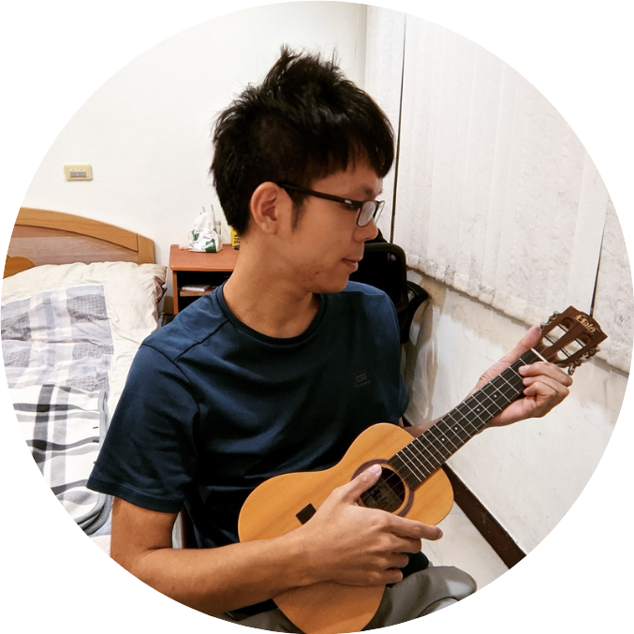
Talks Live Stream’s Metrics
Category：Data Analysis
Live Channel：Day1 R1
127
Total Views
(Dec. to Dec.)
86
48+
86 + 41
Views Counted
(Dec. to Dec.)
Live Viewers
(Concurrent)
游騰林 Tony
Live Viewers
(Concurrent)
Views Counted
(Dec. to Dec.)
Topic：產業、應用與待遇 - Python 在勞動市場中的職缺分析(2021)
86
41+
Views Counted
(Dec. to Dec.)
Live Viewers
(Concurrent)

Slide 40
Tutorial Live Stream’s Metrics
134
Category：Application
Live Channel：Day1 R3
Total Views
(Dec. to Dec.)
70 + 64
70
69+
3rd
Live Viewers
(Concurrent)
Views Counted
(Dec. to Dec.)
Live Viewers
(Concurrent)
Views Counted
(Dec. to Dec.)
Highest Engagement Rate
游騰林 Tony
Note: Engagement Rate represent the degree of interaction between speakers and participants
(measured by the number of viewers and questions they raised from the live stream)
Topic：網路爬蟲即學即用 - 透過 Python 快速蒐集人力銀行的職缺資訊

Slide 41

Reference for the Volume of Booths Traffic
Clicks at your booth
212
times
(max)
Note: There are 46 interactive objects at booths in total,
and the overall clicks collected from sponsors’ booths are 4,346 times
Notes:
國泰金控

Slide 42






PyCon TW offiicia website：https://tw.pycon.org/
Contact us：sponsorship@pycon.tw
Notes:
最末頁

Slide 43

Reference for the Volume of Booths Traffic
Clicks at your booth
270
times
(max)
Note: There are 46 interactive objects at booths in total,
and the overall clicks collected from sponsors’ booths are 4,346 times
Notes:
OneDegree

Slide 44

Reference for the Volume of Booths Traffic
Clicks at your booth
267
times
(max)
Note: There are 46 interactive objects at booths in total,
and the overall clicks collected from sponsors’ booths are 4,346 times
Notes:
iCHEF

Slide 45
Reference for the Volume of Booths Traffic
Clicks at your booth
136
times
(max)
Note: There are 46 interactive objects at booths in total,
and the overall clicks collected from sponsors’ booths are 4,346 times
Notes:
永豐金證券

Slide 46
Reference for the Volume of Booths Traffic
Clicks at your booth
152
times
(max)
Note: There are 46 interactive objects at booths in total,
and the overall clicks collected from sponsors’ booths are 4,346 times
Notes:
KKBOX Group

Slide 47
Reference for the Volume of Booths Traffic
Clicks at your booth
192
times
(max)
Note: There are 46 interactive objects at booths in total,
and the overall clicks collected from sponsors’ booths are 4,346 times
Notes:
玉山銀行

Slide 48
Reference for the Volume of Booths Traffic
Clicks at your booth
154
times
(max)
Note: There are 46 interactive objects at booths in total,
and the overall clicks collected from sponsors’ booths are 4,346 times
Notes:
Appier

Slide 49
Reference for the Volume of Booths Traffic
Clicks at your booth
102
times
(max)
Note: There are 46 interactive objects at booths in total,
and the overall clicks collected from sponsors’ booths are 4,346 times
Notes:
kloudless

Slide 50
Reference for the Volume of Booths Traffic
Clicks at your booth
112
times
(max)
Note: There are 46 interactive objects at booths in total,
and the overall clicks collected from sponsors’ booths are 4,346 times
Notes:
BerryAI

Slide 51
Sponsor | Max Count | Ranking
永豐金證券 | 136
國泰金控 | 212 | 3
KKBOX Group | 152
玉山銀行 | 192
Appier | 154
iCHEF | 267 | 2
kloudless | 102
OneDegree | 270 | 1
BerryAI | 112
PSF | 10
天瓏書局 | 136

